Slide 1

ADO – Delivery Plans

Slide 2
Delivery plan
A delivery plan shows the scheduled work items by sprint (iteration path) of selected teams against a calendar view.
Use the Delivery Plans feature to ensure that your teams are aligned with your organizational goals. You can view multiple backlogs and multiple teams across your whole account.
Delivery Plans supports these tasks:
View up to 15 team backlogs, including a mix of backlogs and teams from different projects.
Add custom portfolio backlogs and epics.
View work items that span several iterations.
Reset start date and target date through drag-and-drop borders.
Add backlog items to a team from a plan.
View rollup progress of features, epics, and other portfolio items.
View dependencies that exist between work items.
Enable stakeholders to view plans.

Slide 3
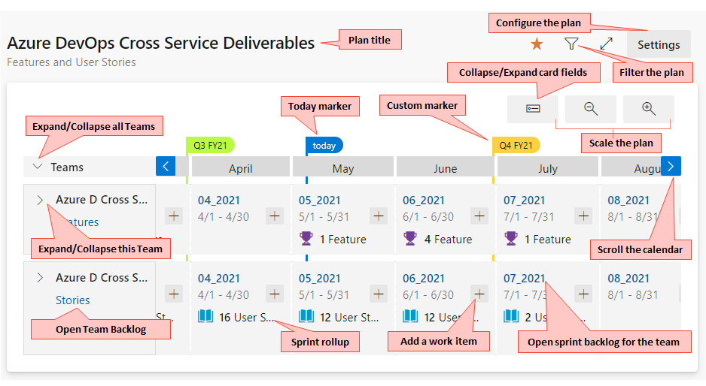
Interact with a plan

Slide 4
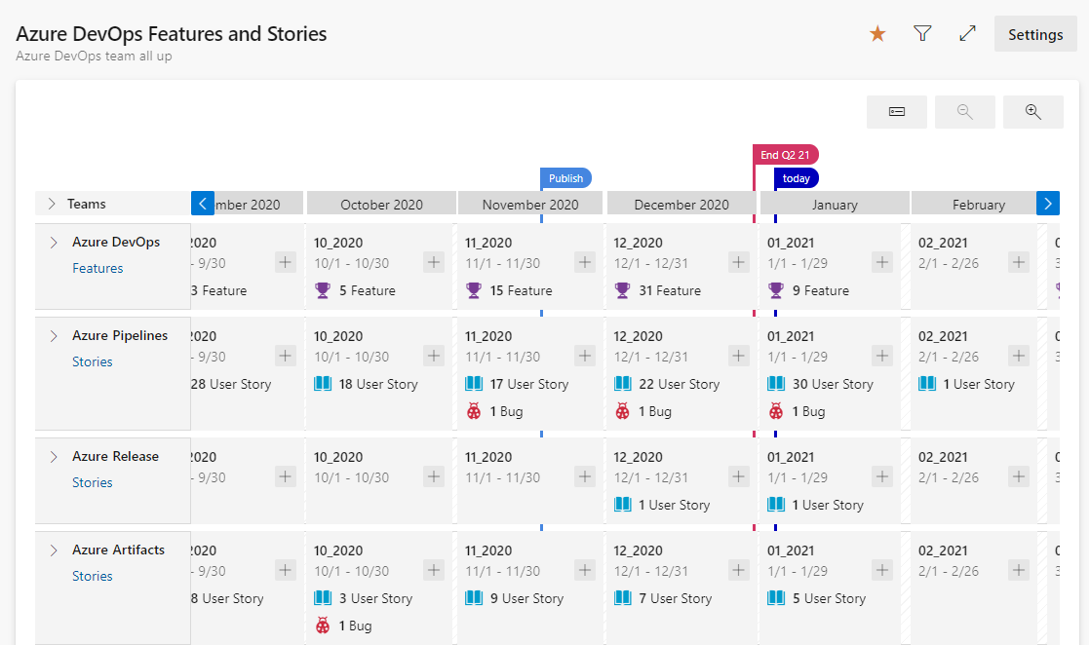
Collapse teams for summary information

Slide 5
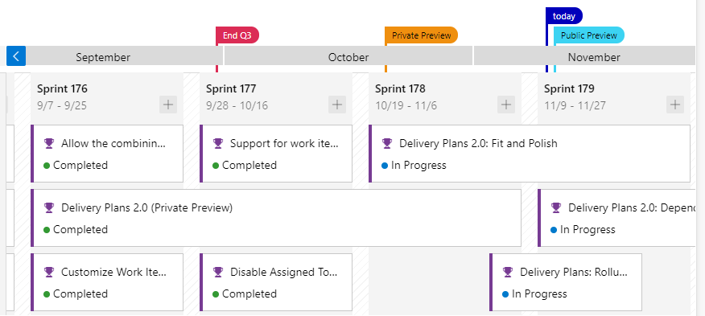
Work that spans one or more iterations

